Slide 1


Introduction of ENQA
Art of self-reflection for constant enhancement: the purpose and objectives of the review
Paula Ranne, Deputy Director
European Association for the Quality Assurance of Higher Education (ENQA)

Slide 2
The European Higher Education Area (AREA)
  As the main objective of the Bologna Process since its inception in 1999, the European Higher Education Area was meant to ensure more comparable, compatible and coherent systems of higher education in Europe. Between 1999 - 2010, all the efforts of the Bologna Process members were targeted to creating the European Higher Education Area, which became reality with the Budapest-Vienna Declaration of March 2010.
  (https://en.wikipedia.org/wiki/European_Higher_Education_Area)

Slide 3
The European Higher Education Area (AREA)
48 countries - Europe is diverse!
Education policies based on subsidiarity
The Bologna Process a voluntary process
Quality assurance an action line in the Bologna Process since the beginning (1999)
Standards and Guidelines for Quality Assurance in the European Higher Education area (ESG) the common framework for QA (2005)
European Quality Assurance Register (2008)

Slide 4

European Association for Quality Assurance in Higher Education (ENQA)
Umbrella NGO for European quality assurance agencies
Network in 2000; association in 2004
Structure: Board, General Assembly, Secretariat
53 Members in 29 countries, 54 Affiliates in 31 countries

Slide 5
European Association for Quality Assurance in Higher Education (ENQA)
Consultative member in the Bologna Follow-up Group since 2005
Co-operation within E4 (European University Association, European Students Union, European Association of Institutions in Higher Education)
External reviews of QA agencies
Founding member of the European Quality Assurance Register (EQAR)
Membership services

Slide 6
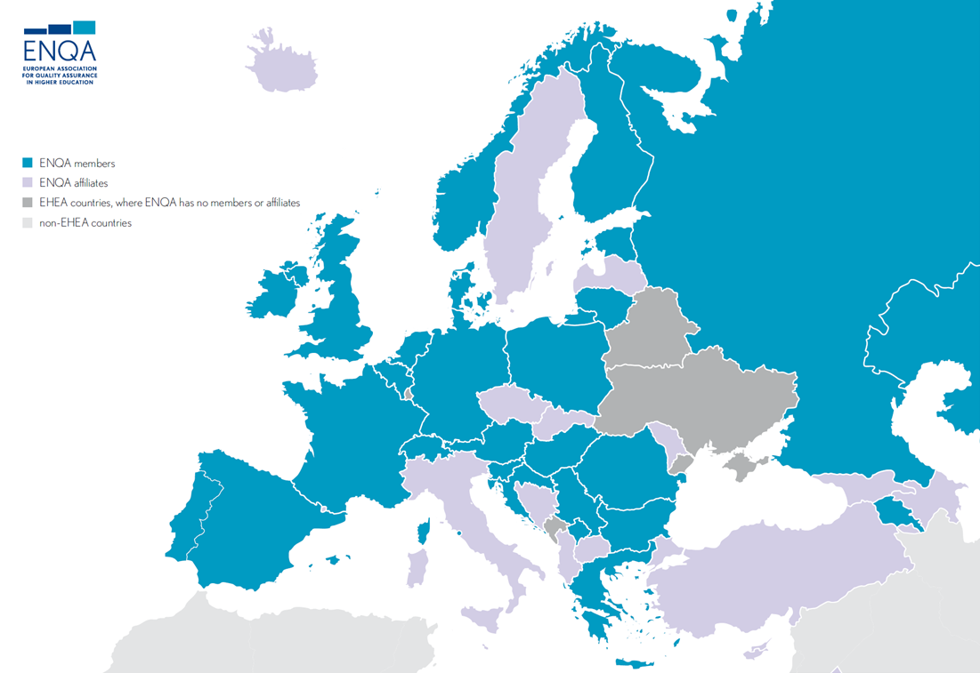

Slide 7

Global reach of ENQA’s activities
Quality Assurance of Cross-Border Higher Education (QACHE)
EU Support to Higher Education in ASEAN Region (SHARE)
Modernizing and Enhancing Indian eLearning Educational Strategies (MIELES)
Harmonisation of African Higher Education Quality Assurance and Accreditation (HAQAA)

Slide 8
European Standards and Guidelines (ESG)
PART 1. INTERNAL QUALITY ASSURANCE
PART 2. EXTERNAL QUALITY ASSURANCE
PART 3. QUALITY ASSURANCE AGENCIES

Slide 9
Main principles for QA in Europe
Higher education institutions have primary responsibility for the quality of their provision and its assurance
QA responds to the diversity of HE systems, institutions and programmes (as well as of agencies)
QA supports the development of a quality culture
QA involves stakeholders and takes into account the expectations of all stakeholders and society

Slide 10
Main principles for QA in Europe
Standards and guidelines for QA, not quality as such
Apply to all higher education offered in the EHEA regardless of the mode of study or place of delivery (TNE, e-learning, short courses…)
Apply to all types of QA activities and agencies (quality audits, programme accreditation, institutional assessment...)

Slide 11
Main principles for QA in Europe
Independence of QA agencies (not parts of the ministry)
Provides transparent and independent information on the quality of HEIs and programmes
External and internal QA build on each other (one is not complete without the other)
Students are equal partners

Slide 12
External reviews of agencies
12 months
Involves commitment and resources from all parties
Not a review by ENQA but by peers: Critical friends – friendly critics
Meaningful self-assessment prepares for meaningful outcomes
Only you know your context

Slide 13
SAR at the <3 of the process
A snapshot contributing to the bigger picture of external quality assurance in the EHEA
At the same time, not to be written to the panel or ENQA but to yourselves and to your local readers

Slide 14

Support mechanisms
Review coordinator
ESG
Stakeholders
Review guidelines
National authorities
Sufficient time and resources
Existing reports

Slide 15
Thank you!

