Slide 1
ENQA Agency Reviews – main changes from the old review process
Agnė Grajauskienė
Reviews Manager
ENQA

Slide 2
Revised model for ENQA Agency Reviews
Clearer, better-structured, more efficient, and more useful approach to external quality assurance of QA agencies
Revised guidelines

Slide 3
Remit of the review
No additional membership criteria anymore,
agency has to comply with ESG Parts II and III
All ESG standards of Parts 2 and 3 need to be fully covered
Each ESG standard should be discussed separately
All quality assurance activities
Notes:
The reviews will cover all quality assurance activities of the agency under review, regardless of whether they are carried out in the agency’s predominant country/region of operation, in other countries of the EHEA, or outside the EHEA and regardless of whether they are compulsory or voluntary in nature.

Slide 4
Remit of the review
The first ESG review: specific attention to the policies, procedures, and criteria in place. Full evidence of concrete results in all areas may not be required at this stage e.g. completed reports of thematic analyses. However, the agency must be able to document (as in action plans with timetables) how they are able to achieve results according to all standards by the next review.
The second and subsequent reviews: clear evidence of results in all areas. Further reviews will need to acknowledge progress from the previous review - mandatory element in both the SAR and the panel report.
All reviews – whether first, second, or subsequent – must always have
a developmental approach and aim at constant enhancement of the agencies.

Slide 5
Review panel
4 panel members instead of 5:
one or two quality assurance professionals (at least one should be currently employed by a QA agency and both having been engaged in quality assurance within the past 5 years);
academic currently employed at a higher education institution;
student member.
When requested or when considered particularly pertinent, other stakeholders e.g. representative of the labour market may be included instead of the second quality assurance professional or in addition to the four panel members.

Slide 7
All panel members must have been trained by ENQA.
At least 2 panel members from outside the national system of the agency.
The review chair and the review secretary may not come from the same country
The review chair should not come from the country of the agency under review
At least one member has good knowledge and understanding of the higher education and quality assurance system in which the agency (predominantly) operates.
At least one panel member has fluent knowledge of the main working language of the agency and/or the language of the country in which the agency (predominantly) operates.
Gender balance is taken into consideration. A panel never has only male or only female members.
No current nor former members (last five years) of staff of the agency under review can take part in the review panel.
Current members of the ENQA Board are not eligible to serve as reviewers in ENQA Agency Reviews.
The review chair will have previous experience taking part in an ENQA Agency Review.
The review secretary will normally have previous experience taking part in an ENQA Agency Review.
Whenever possible, at least one panel member will not have previously participated in an ENQA Agency Review.

Slide 8
ENQA review coordinator
Monitoring (integrity of the process) and support role:
Checks the SAR – not to judge the content but to ensure that it provides sufficient information and conforms to the Guidelines
Supports the panel in the practical arrangements
Attends the site visit to ensure that ENQA’s expectations of the review are considered, supports the panel
Pre-screens the draft report for consistency, clarity and language
BUT not taking the role of the secretary in terms of notes, report writing etc.

Slide 9
Guide of content for the SAR
In order to harmonise the contents of the SARs, in terms of level of detail, thoroughness, and evaluative character, agencies are expected to follow the guide of content provided in the Guidelines (Annex I)

Slide 10
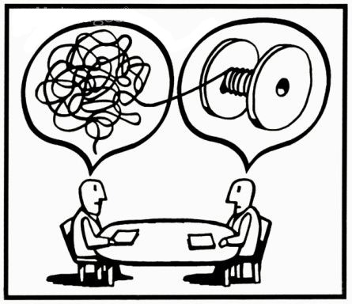
Meeting with agency’s resource person
Panel may request to make use of an “agency resource person” to clarify elements related to the overall system and context, so that time during the interview sessions may be used in full for verification of the agency’s ESG compliance.
Senior member of staff with sufficient knowledge on the history and present situation of the agency and the QA and higher education system in question
Would likely not be the person in charge of the organisation of the review process at the agency.

Slide 11
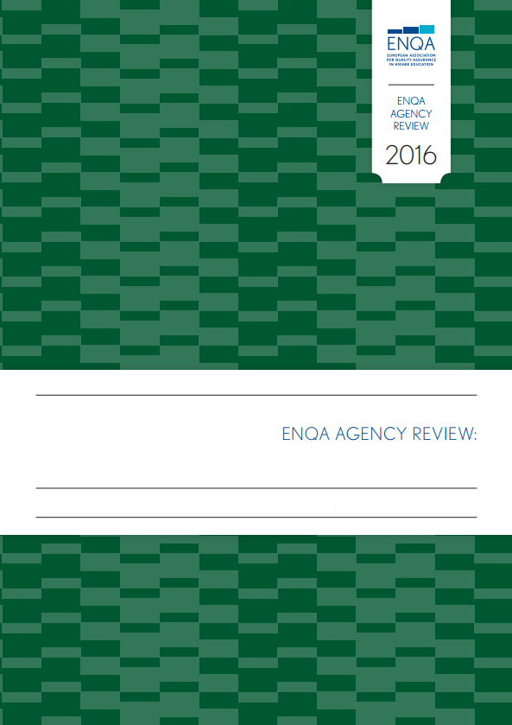
Template for the final report
For all ENQA Agency Reviews, the ERR must be submitted using the provided template (Annex IV)
More detailed guidance on what should be included
in each of the sections

Slide 12
In addition to the review report, the agency applying for ENQA membership/renewal of membership is asked to provide a letter outlining its motivation:
Describing briefly the agency’s motivation for ENQA membership/renewal of membership
How the agency wishes to contribute to the ENQA community

Slide 13
Progress visit
Follow-up report within two years of the Board’s positive decision. May be reduced to one year in cases where urgent action is considered necessary.
Progress visit – additional service, non-investigative nature.
Voluntary progress visit is aimed to generate a stronger enhancement-oriented dialogue. Two years after the completion of the review process, by two reviewers from the original review panel (when possible).

Slide 15
Thank you!

